Slide 1
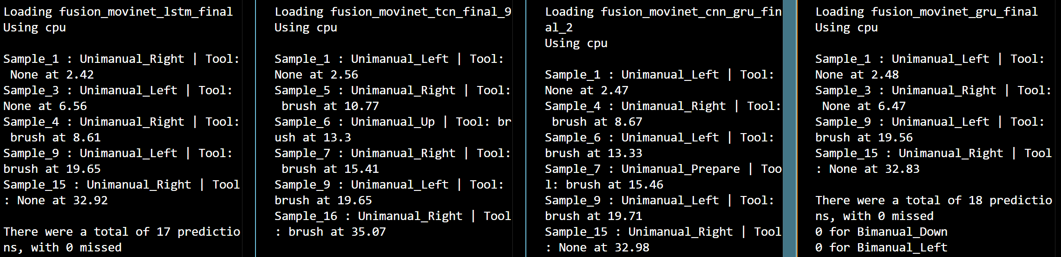
Sequence of movements | Sample
Unimanual_Left | 1
Unimanual_Right | 5
Unimanual_Left | 10
Unimanual_Right | 18
Fast prediction

Slide 2
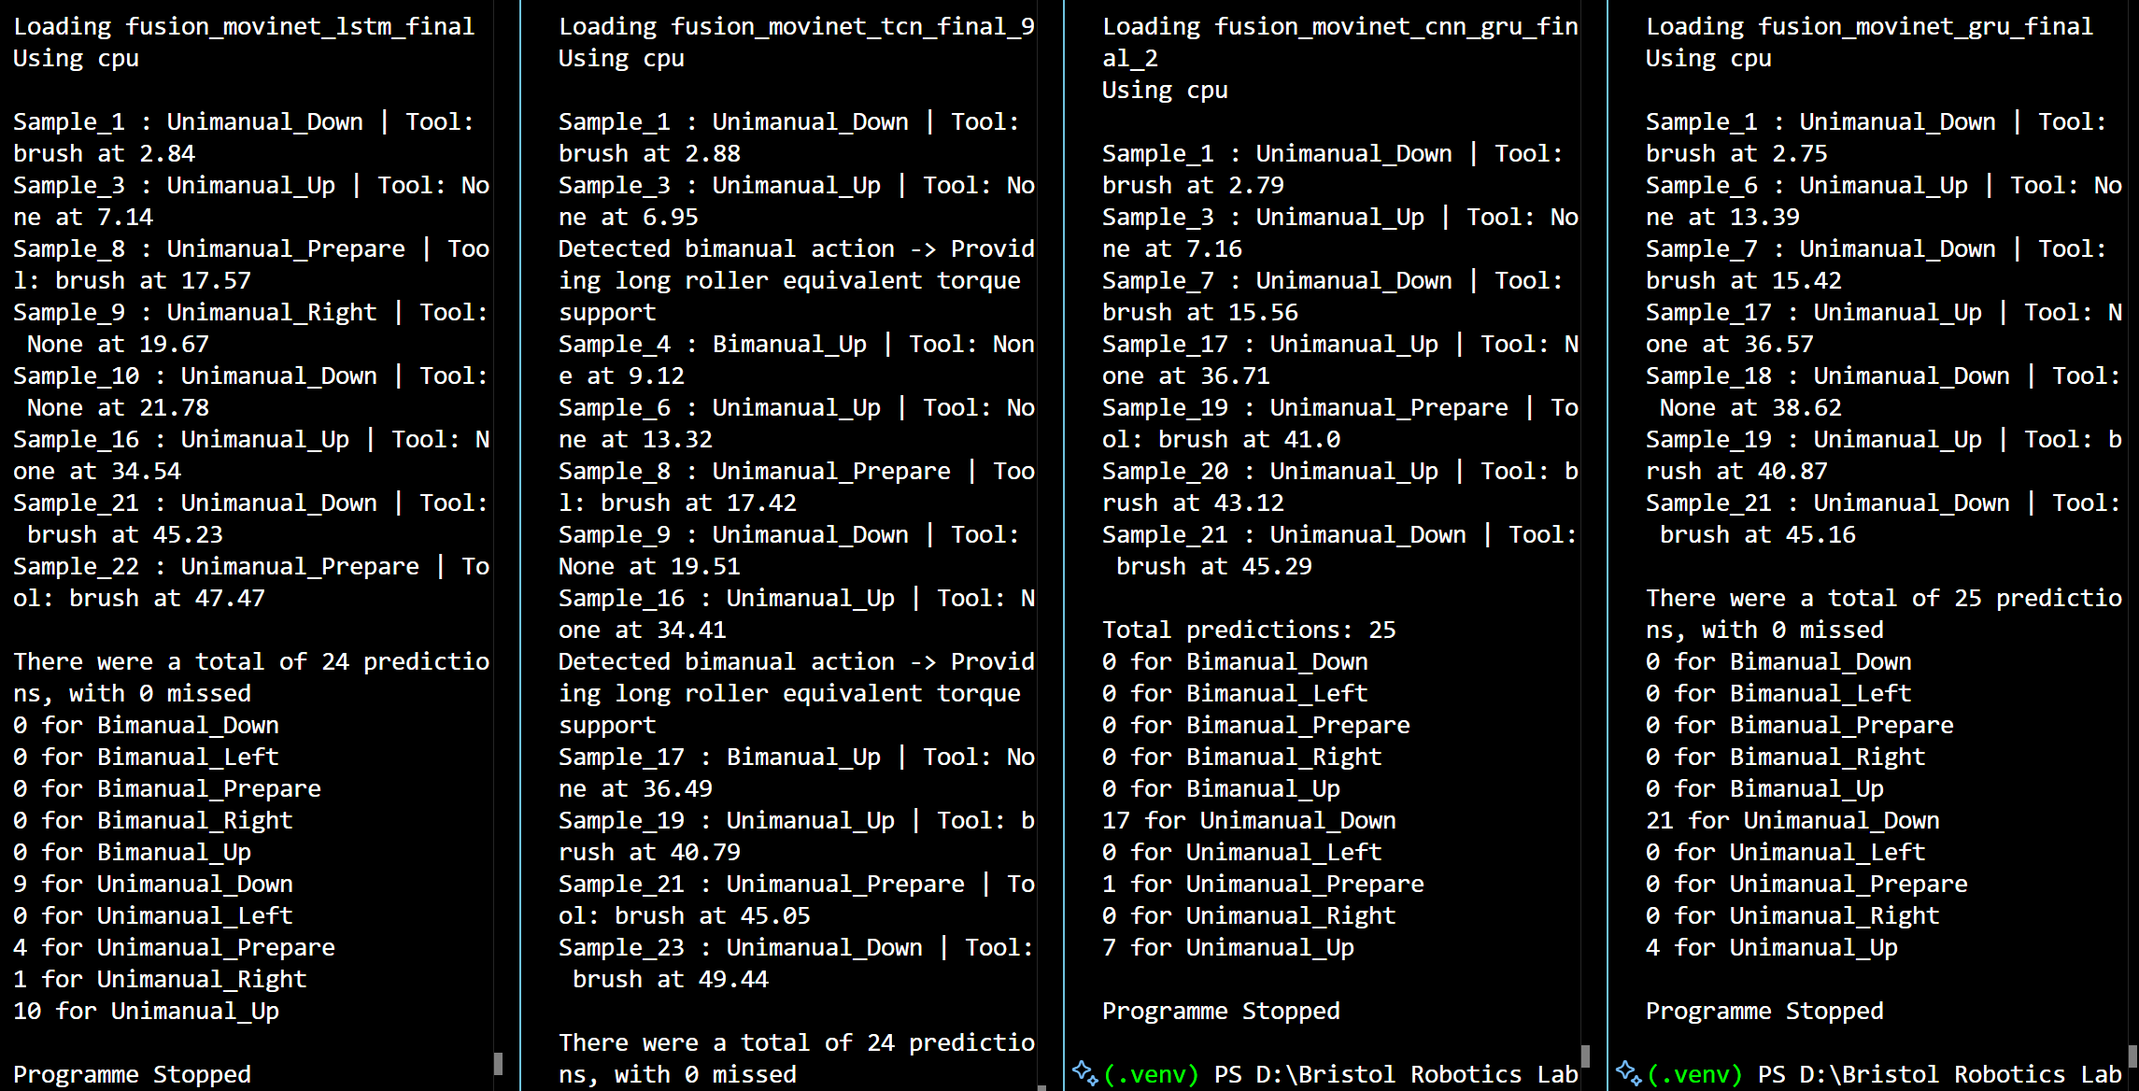
Sequence of movements | Sample
Unimanual_Down | 1
Unimanual_Up | 5
Unimanual_Down | 9
Unimanual_Up | 17

